Slide 1
MapReduce Algorithm Design
Big Data Mining and Analytics
Dr. Latifur Khan
Department of Computer Science
University of Texas at Dallas
(Chapter 3: Jimmy Lin and Chris Dyer, Data-Intensive Text Processing with MapReduce, Morgan & Claypool Publishers, 2010.) http://lintool.github.com/MapReduceAlgorithms/
This work is licensed under a Creative Commons Attribution-Noncommercial-Share Alike 3.0 United States See http://creativecommons.org/licenses/by-nc-sa/3.0/us/ for details

Slide 2
Sort
Each Reducer is responsible for reducing the values associated with (several) intermediate keys
The set of intermediate keys on a single node is automatically sorted by MapReduce before they are presented to the Reducer
Files loaded from local HDFS store
InputFormat
file
Split
Split
Split
file
RR
RR
RR
Map
Map
Map
Partitioner
Sort
Reduce

Slide 3
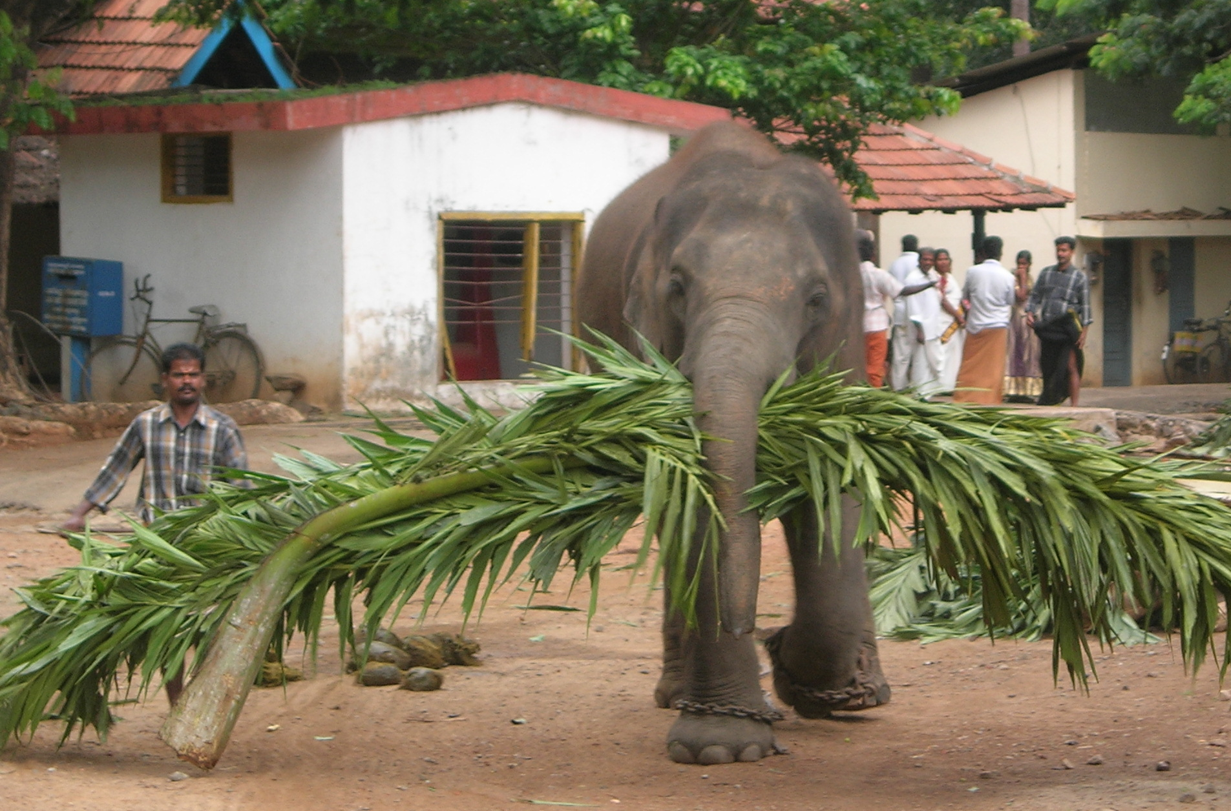
Source: Wikipedia (Mahout)

Slide 4
MapReduce: Recap
Programmers must specify:
map (k, v) → <k’, v’>*
reduce (k’, v’) → <k’, v’>*
All values with the same key are reduced together
Optionally, also:
partition (k’, number of partitions) → partition for k’
Often a simple hash of the key, e.g., hash(k’) mod n
Divides up key space for parallel reduce operations
combine (k’, v’) → <k’, v’>*
Mini-reducers that run in memory after the map phase
Used as an optimization to reduce network traffic
The execution framework handles everything else…

Slide 5
k₁
v₁
k₂
v₂
k₃
v₃
k₄
v₄
k₅
v₅
k₆
v₆
map
map
map
map
a
1
b
2
c
3
c
6
a
5
c
2
b
7
c
8
combine
combine
combine
combine
a
1
b
2
c
9
a
5
c
2
b
7
c
8
partition
partition
partition
partition
Shuffle and Sort: aggregate values by keys
a
1
5
b
2
7
c
2
9
8
reduce
reduce
reduce
r₁
s₁
r₂
s₂
r₃
s₃
Notes:
<number>

Slide 6
“Everything Else”
The execution framework handles everything else…
Scheduling: assigns workers to map and reduce tasks
“Data distribution”: moves processes to data
Synchronization: gathers, sorts, and shuffles intermediate data
Errors and faults: detects worker failures and restarts
Limited control over data and execution flow
All algorithms must expressed in m, r, c, p
You don’t know:
Where mappers and reducers run
When a mapper or reducer begins or finishes
Which input a particular mapper is processing
Which intermediate key a particular reducer is processing

Slide 7
Tools for Synchronization
Cleverly-constructed data structures
Bring partial results together
Sort order of intermediate keys
Control order in which reducers process keys
Partitioner
Control which reducer processes which keys
Preserving state in mappers and reducers
Capture dependencies across multiple keys and values

Slide 8
Preserving State
Mapper object
Reducer object
one object per task
state
state
configure
API initialization hook
configure
map
one call per input key-value pair
reduce
one call per intermediate key
close
API cleanup hook
close

Slide 9
Scalable Hadoop Algorithms: Themes
Avoid object creation
Inherently costly operation
Garbage collection
Avoid buffering
Limited heap size
Works for small datasets, but won’t scale!

Slide 10
Importance of Local Aggregation
Ideal scaling characteristics:
Twice the data, twice the running time
Twice the resources, half the running time
Why can’t we achieve this?
Synchronization requires communication
Communication kills performance
Thus… avoid communication!
Reduce intermediate data via local aggregation
Combiners can help

Slide 11
Mapper
Mapper
Mapper
Mapper
Mapper
Intermediates
Intermediates
Intermediates
Intermediates
Intermediates
Partitioner
Partitioner
Partitioner
Partitioner
Partitioner
(combiners omitted here)
Intermediates
Intermediates
Intermediates
Reducer
Reducer
Reduce
Source: redrawn from a slide by Cloduera, cc-licensed

Slide 12
k₁
v₁
k₂
v₂
k₃
v₃
k₄
v₄
k₅
v₅
k₆
v₆
map
map
map
map
a
1
b
2
c
3
c
6
a
5
c
2
b
7
c
8
combine
combine
combine
combine
a
1
b
2
c
9
a
5
c
2
b
7
c
8
partition
partition
partition
partition
Shuffle and Sort: aggregate values by keys
a
1
5
b
2
7
c
2
9
8
reduce
reduce
reduce
r₁
s₁
r₂
s₂
r₃
s₃
Notes:
<number>

Slide 13
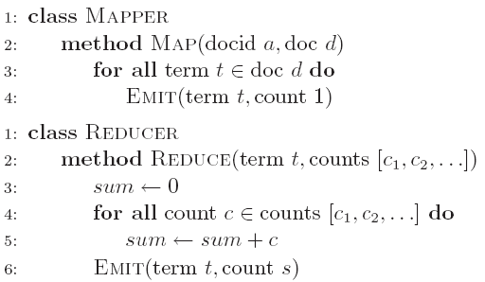
Word Count: Baseline
What’s the impact of combiners?

Slide 14
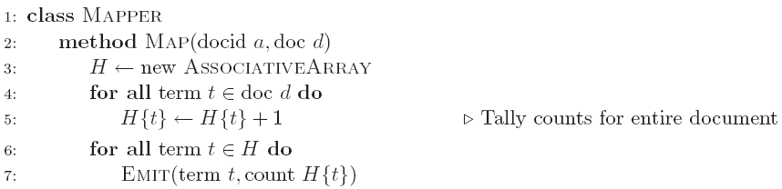
Word Count: Version 1
Are combiners still needed?

Slide 15
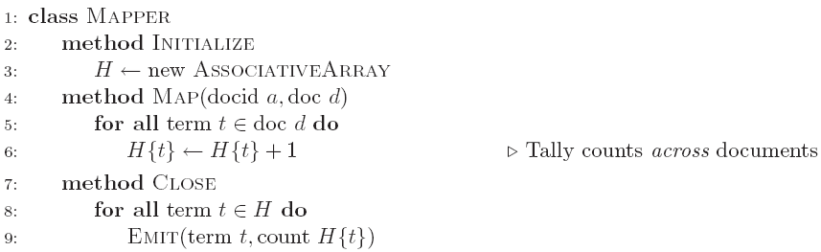
Word Count: Version 2
Key: preserve state across input key-value pairs!
Are combiners still needed?

Slide 16
Design Pattern for Local Aggregation
“In-mapper combining”
Fold the functionality of the combiner into the mapper by preserving state across multiple map calls
Advantages
Speed
Why is this faster than actual combiners?
Disadvantages
Explicit memory management required
Potential for order-dependent bugs

Slide 17
Combiner Design
Combiners and reducers share same method signature
Sometimes, reducers can serve as combiners
Often, not…
Remember: combiner are optional optimizations
Should not affect algorithm correctness
May be run 0, 1, or multiple times
Example: find average of all integers associated with the same key

Slide 18
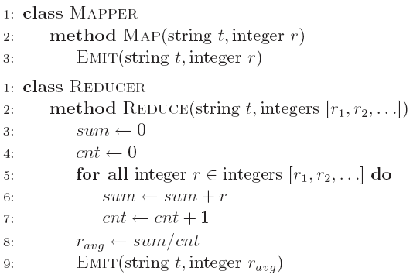
Computing the Mean: Version 1
Why can’t we use reducer as combiner?

Slide 19
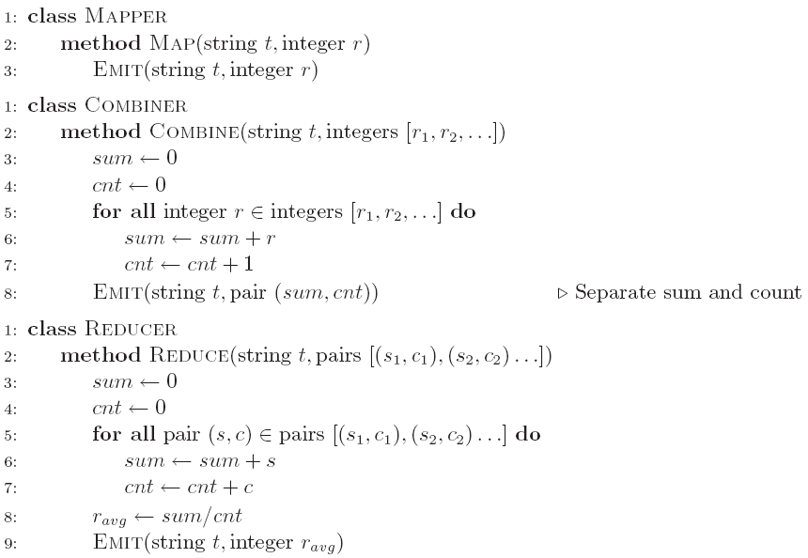
Computing the Mean: Version 2
Why doesn’t this work?

Slide 20
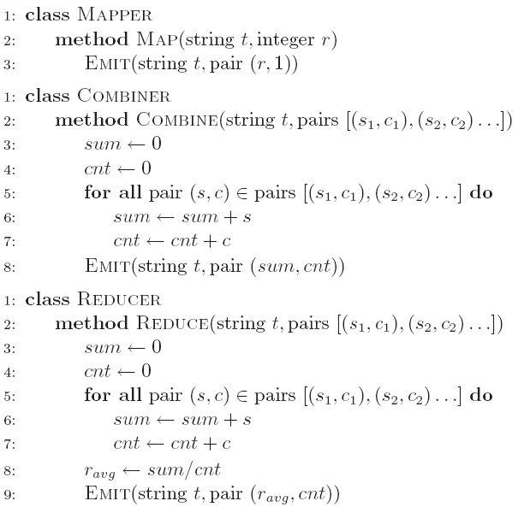
Computing the Mean: Version 3
Fixed?

Slide 21
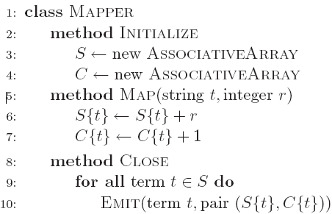
Computing the Mean: Version 4
Are combiners still needed?

Slide 22
Algorithm Design: Running Example
Term co-occurrence matrix for a text collection
M = N x N matrix (N = vocabulary size)
M_{ij}: number of times i and j co-occur in some context (for concreteness, let’s say context = sentence)
Why?
Distributional profiles as a way of measuring semantic distance
Semantic distance useful for many language processing tasks

Slide 23
MapReduce: Large Counting Problems
Term co-occurrence matrix for a text collection = specific instance of a large counting problem
A large event space (number of terms)
A large number of observations (the collection itself)
Goal: keep track of interesting statistics about the events
Basic approach
Mappers generate partial counts
Reducers aggregate partial counts
How do we aggregate partial counts efficiently?

Slide 24
First Try: “Pairs”
Each mapper takes a sentence:
Generate all co-occurring term pairs
For all pairs, emit (a, b) → count
Reducers sum up counts associated with these pairs
Use combiners!

Slide 25
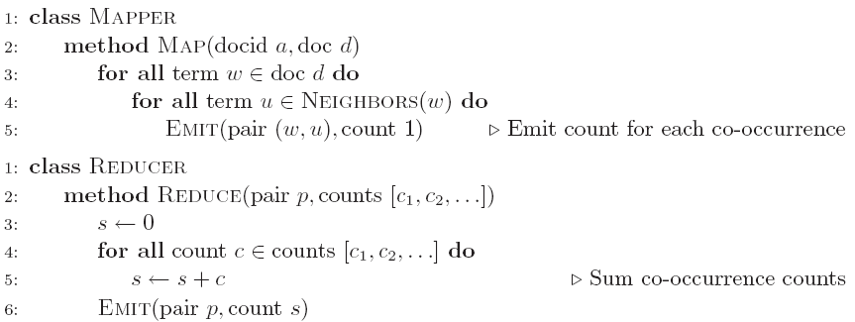
Pairs: Pseudo-Code

Slide 26
“Pairs” Analysis
Advantages
Easy to implement, easy to understand
Disadvantages
Lots of pairs to sort and shuffle around (upper bound?)
Not many opportunities for combiners to work

Slide 27
Another Try: “Stripes”
Idea: group together pairs into an associative array
Each mapper takes a sentence:
Generate all co-occurring term pairs
For each term, emit a → { b: count_{b}, c: count_{c}, d: count_{d} … }
Reducers perform element-wise sum of associative arrays
(a, b) → 1
(a, c) → 2
(a, d) → 5
(a, e) → 3
(a, f) → 2
a → { b: 1, c: 2, d: 5, e: 3, f: 2 }
a → { b: 1, d: 5, e: 3 }
a → { b: 1, c: 2, d: 2, f: 2 }
a → { b: 2, c: 2, d: 7, e: 3, f: 2 }
+
Key: cleverly-constructed data structure
brings together partial results

Slide 28
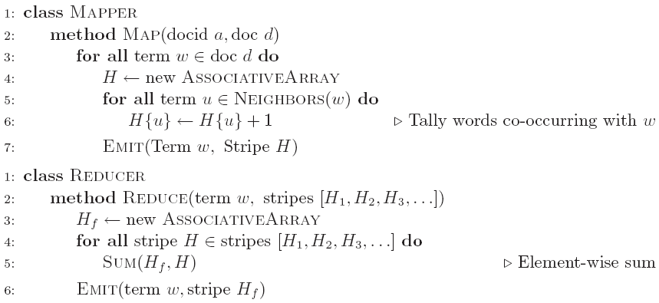
Stripes: Pseudo-Code

Slide 29
“Stripes” Analysis
Advantages
Far less sorting and shuffling of key-value pairs
Can make better use of combiners
Disadvantages
More difficult to implement
Underlying object more heavyweight
Fundamental limitation in terms of size of event space

Slide 30
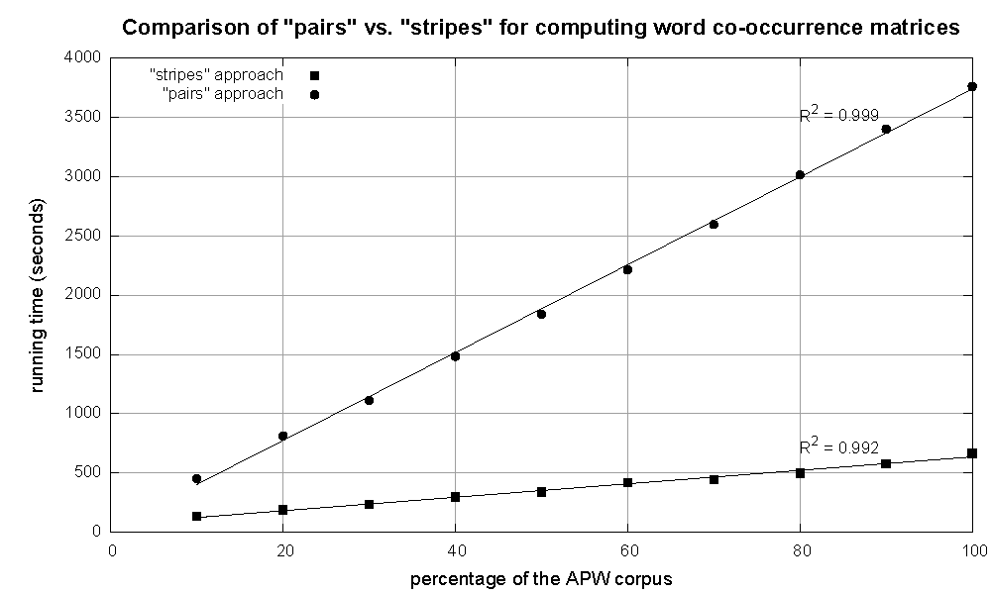
Cluster size: 38 cores
Data Source: Associated Press Worldstream (APW) of the English Gigaword Corpus (v3), which contains 2.27 million documents (1.8 GB compressed, 5.7 GB uncompressed)

Slide 31
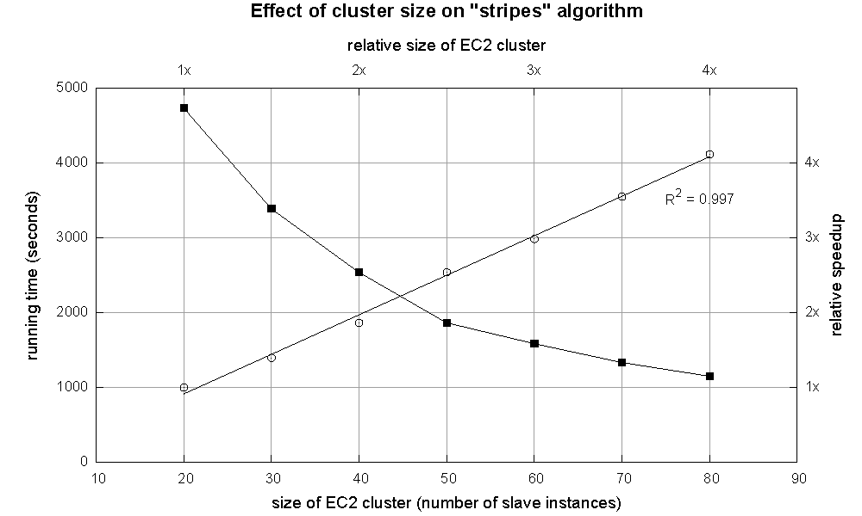

Slide 32
Relative Frequencies
How do we estimate relative frequencies from counts?
Why do we want to do this?
How do we do this with MapReduce?

Slide 33
f(B|A): “Stripes”
Easy!
One pass to compute (a, *)
Another pass to directly compute f(B|A)
a → {b₁:3, b₂ :12, b₃ :7, b₄ :1, … }

Slide 34
f(B|A): “Pairs”
For this to work:
Must emit extra (a, *) for every b_{n} in mapper
Must make sure all a’s get sent to same reducer (use partitioner)
Must make sure (a, *) comes first (define sort order)
Must hold state in reducer across different key-value pairs
(a, *) → 32
Reducer holds this value in memory
(a, b₁) → 3
(a, b₂) → 12
(a, b₃) → 7
(a, b₄) → 1
…
(a, b₁) → 3 / 32
(a, b₂) → 12 / 32
(a, b₃) → 7 / 32
(a, b₄) → 1 / 32
…

Slide 35
f(B|A): “Pairs”
class MAPPER
method MAP(docid a, doc d )
for all term w ϵ doc d do
for all term u ϵ NEIGHBOURS(w) do
EMIT( pair(w,u), count 1)
EMIT( pair(w,*), count 1)
method COMPARETO( pair p1, pair p2)
if (*ϵ p1) return p1
if (*ϵ p2) return p2
else return compare(p1.left, p2.left)
class PARTITIONER
method GETPARTITION(pair p, count c)
return p.left.hasCode( )% numReducers

Slide 36
f(B|A): “Pairs”
class REDUCER
method INITIALIZE()
MC ← 0
method REDUCE( pair p, counts[c1,c2,…..] )
if (p.right.equals(*))
MC ← 0
for all count c ϵ counts[c1,c2,…..] do
MC ← MC + c
sum ← 0
rf ← 0
for all count c ϵ counts[c1,c2,…..] do
sum ← sum + c
rf ← sum/MC
EMIT(pair p, rf )

Slide 37
“Order Inversion”
Common design pattern
Computing relative frequencies requires marginal counts
But marginal cannot be computed until you see all counts
Buffering is a bad idea!
Trick: getting the marginal counts to arrive at the reducer before the joint counts
Optimizations
Apply in-memory combining pattern to accumulate marginal counts
Should we apply combiners?

Slide 38
Synchronization: Pairs vs. Stripes
Approach 1: turn synchronization into an ordering problem
Sort keys into correct order of computation
Partition key space so that each reducer gets the appropriate set of partial results
Hold state in reducer across multiple key-value pairs to perform computation
Illustrated by the “pairs” approach
Approach 2: construct data structures that bring partial results together
Each reducer receives all the data it needs to complete the computation
Illustrated by the “stripes” approach

Slide 39
Secondary Sorting
MapReduce sorts input to reducers by key
Values may be arbitrarily ordered
What if want to sort value also?
E.g., k → (v₁, r), (v₃, r), (v₄, r), (v₈, r)…

Slide 40
Secondary Sorting: Solutions
Solution 1:
Buffer values in memory, then sort
Why is this a bad idea?
Solution 2:
“Value-to-key conversion” design pattern: form composite intermediate key, (k, v₁)
Let execution framework do the sorting
Preserve state across multiple key-value pairs to handle processing
Anything else we need to do?

Slide 41
Recap: Tools for Synchronization
Cleverly-constructed data structures
Bring data together
Sort order of intermediate keys
Control order in which reducers process keys
Partitioner
Control which reducer processes which keys
Preserving state in mappers and reducers
Capture dependencies across multiple keys and values

Slide 42
Issues and Tradeoffs
Number of key-value pairs
Object creation overhead
Time for sorting and shuffling pairs across the network
Size of each key-value pair
De/serialization overhead
Local aggregation
Opportunities to perform local aggregation varies
Combiners make a big difference
Combiners vs. in-mapper combining
RAM vs. disk vs. network

Slide 43
Debugging at Scale
Works on small datasets, won’t scale… why?
Memory management issues (buffering and object creation)
Too much intermediate data
Mangled input records
Real-world data is messy!
Word count: how many unique words in Wikipedia?
There’s no such thing as “consistent data”
Watch out for corner cases
Isolate unexpected behavior, bring local

Slide 44

Questions?
Source: Wikipedia (Japanese rock garden)

